Slide 1




9/20/19
MECH
How to Build A MECH Project Part 1
Notes:
Katamari soundtrack, loco roco

Slide 2
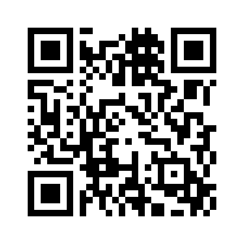

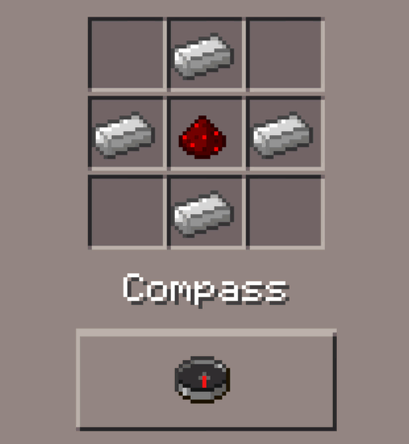


The Projects so Far
https://forms.gle/awXYsPuH6xi4N5BM6
Minecraft Compass
Allergy Machine
Cracking Open a Cold One With the Bots
VR Peripherals
Marshmallow Launcher Redux
Snap, Fizz, Pour Drink Robot
Harry Potter's Sorting Hat

Slide 3

The Project Far Far Away (Last Year)
Ironman
Electrical Engineer for circuit design and switch programming with Arduino and Raspberry Pi
Prosthetic Arm Redux

Slide 4
New Ideas? 👀
Also, want feedback for project? Ask us after workshop

Slide 5
Team Building

Slide 6
The Leader
Each group/project is required to have one
It’s necessary to the whole functioning of your project
The leader is the one who works closely with the eboard (the only difference between a leader and member)
Great resume boost and leadership position
If interested, come talk to us after GBM!

Slide 7
The Soon To Be Squad
Ways to recruit:
Eboard will have google forms sign up once a project leader is decided
Pitch at MECH gbm
Ask in discord
Network during MECH meetings

Slide 8
Project Building

Slide 9
About MECH again
Cool af club
You have idea, we help you make idea
We are your favorite kickstarter backers
Help give you resources and teams and friends and good life
No deadlines, all about progress
Chillllll

Slide 10
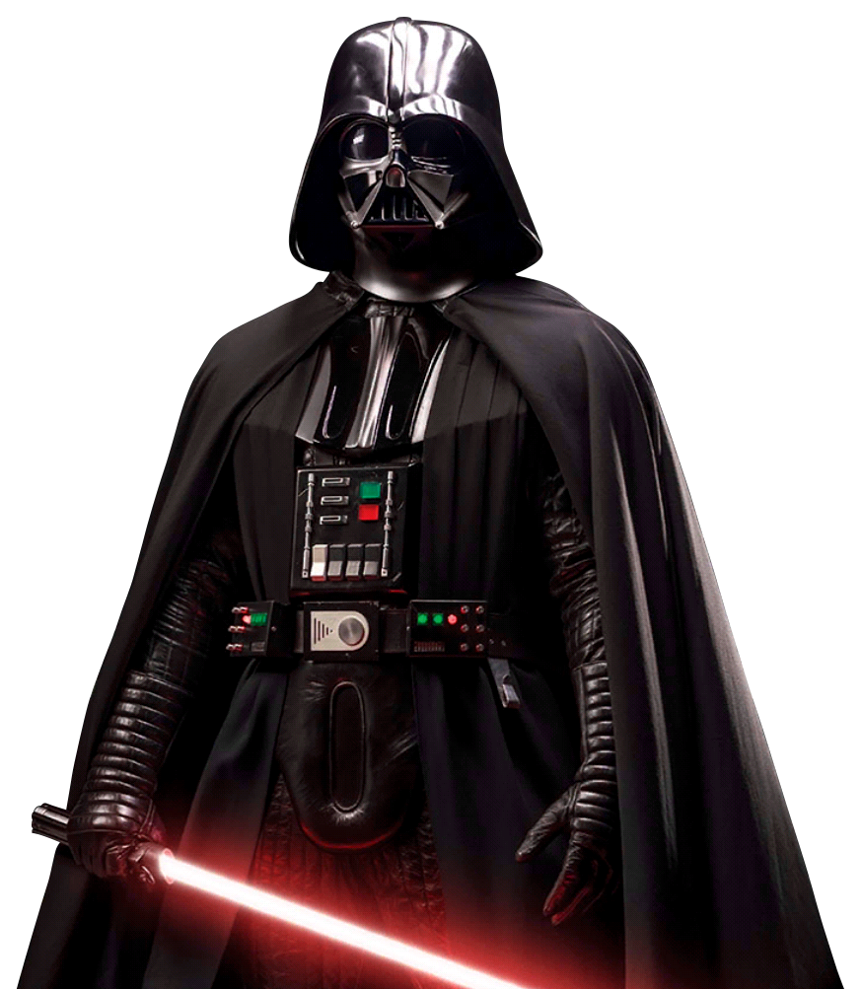
About (the Darkside of) MECH
SG Funded
But limited funding
No deadlines so no accountability
You can work on/keep the parts outside the MECH meetings...some of you REALLY keep them

Slide 11
Rulez
1 project lead, minimum 1 team member
MANDATORY once every 3 weeks, project ““““““demo””””””
If no progress or communication: project comes back to MECH effective immediately
We will find you and we have Master Celestin by our side
Budget and team cap limit*
Finished project? MECH keeps or you pay 50%
Example: Baymax: $200 😞
$200/2 = $100
100/7 members = $14 😍
So pay $200 or $14?

Slide 12
Resource
Github: https://github.com/mechusf
Trello: https://trello.com/mechusf
Discord: unique channel under #projects 19-20
Assigned eboard member
REQUIRED
REQUIRED
REQUIRED

Slide 13
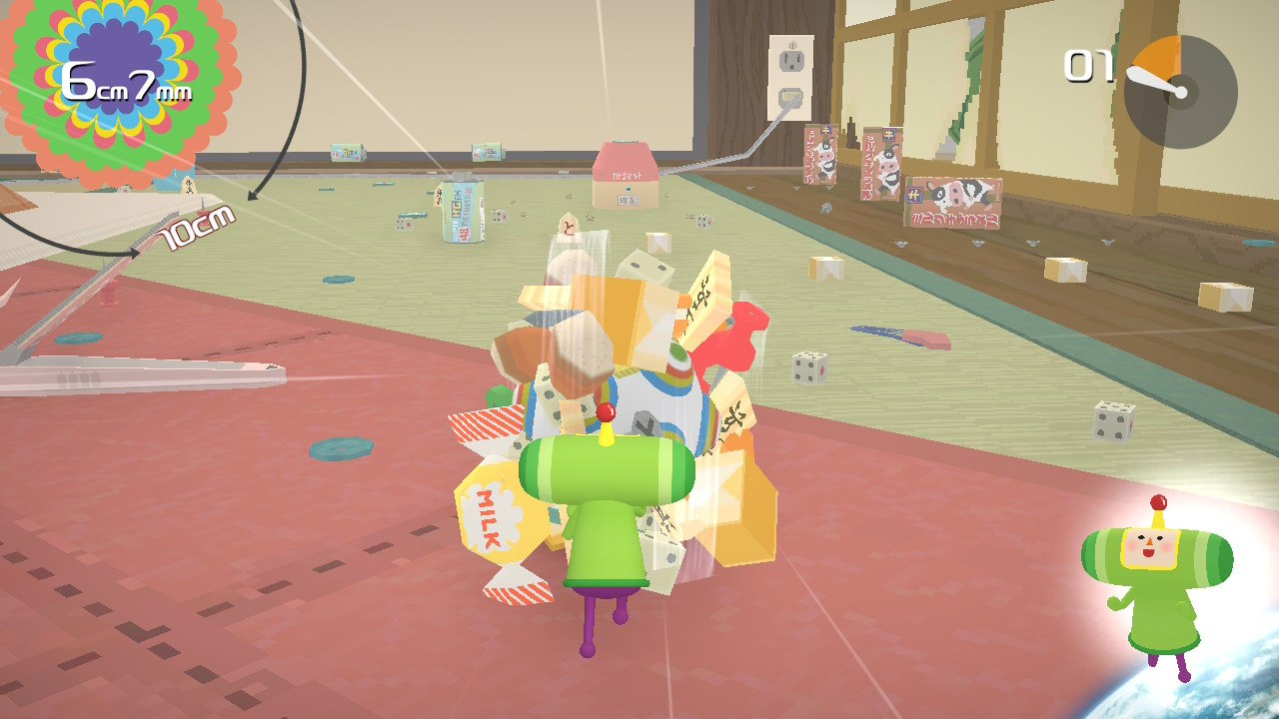
Parts
Previously: parts done in one big order
Now: parts ordered in intervals
Why?
Motivation
Accountability
Save money and time for both sides
Notes:
Qr code here

Slide 14
Skills?
What if my team does not have all the skills?

Slide 15
Recap
NEW Project: 1 project lead and at least 1 team member
ACTIVE Project: “demo” once every 3 weeks, MANDATORY
INACTIVE Project: no progress, give us back de parts
Parts are ordered in intervals, when new progress is made, new projects ordered
FINISHED Project: MECH keeps or you pay 50%

Slide 16
Events and Social Media

Slide 17




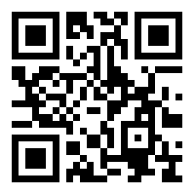

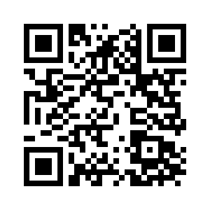
Follow us!
https://bit.ly/2m6ZYuP
Project Approval Form
Next time on MECH...
Build things -- 24/7 all day everyday
Game Night! -- 9/27 -- 5pm
MECH Takes Homecoming with SHPE and AIChE -- 10/11
MECH Takes Roboticon -- 10/12
https://discord.gg/ZvGujV

